Slide 1





CORPORATE PROFILE
Visit Our Website
itcompany.info

Slide 2





OUR VISION
OUR MISSION
Empowering Success Through Excellence
We are committed to providing unparalleled IT solutions & services
Delivering Exceptional IT Business Services and Cutting-Edge Technology Solutions to Empower Your Success.
To Deliver Robust, Secure, and Custom-Tailored Solutions That Meet Enterprise Standards and Drive Your Business Growth.
www.itcompany.info
Notes:
Please update for better view

Slide 3



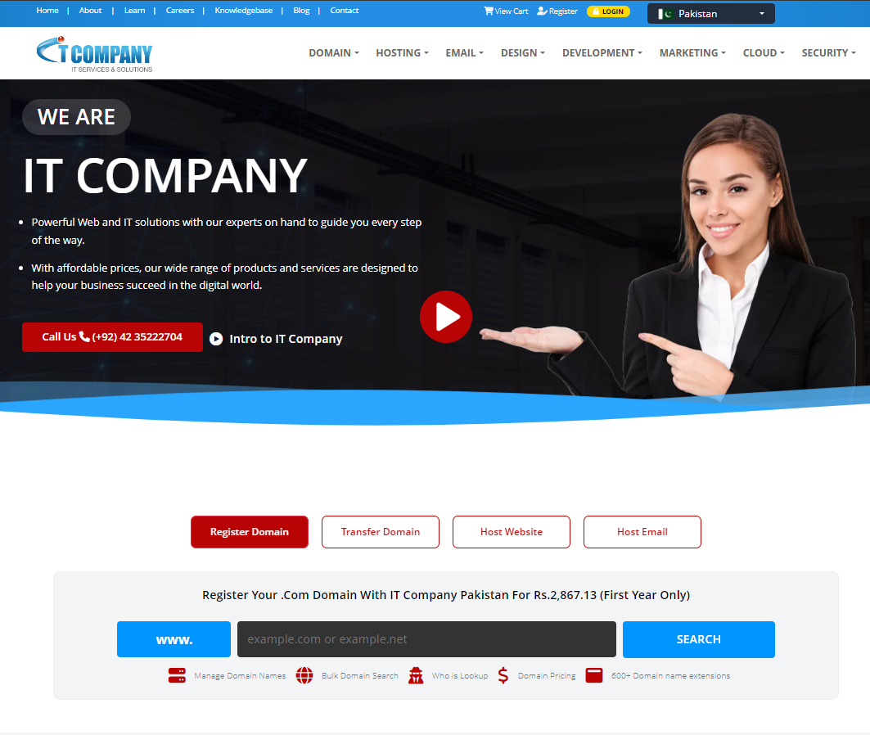
GLOBAL Presence
ONE ROOF
3 CONTINENTS
From Infrastructure to Software Development & Support Services
Data Center & Redundancy
Solution & Service Provider
2007
CUTTING-EDGE
Founded
Technology
www.itcompany.info

Slide 4






CUSTOMER FOCUS
We constantly strive to exceed our customers’ expectations & enable them to excel in their business
OUR CORE VALUES
INNOVATION
We shape the future by creating innovative solutions throughout our operations
FAIR PLAY
We conduct business in​ a sustainable and ​responsible manner
PASSION TO WIN
We are passionate about driving success for our clients and our company.
www.itcompany.info
Notes:
WHAT

Slide 5

SERVICES & PRODUCTS
DOMAIN
AI Workflow
Register Domain Name
Transfer Domain Name
AI Call Answering
AI Leads Generation
AI Chat Assistant
AI Virtual / Admin Assistant
HOSTING
MARKETING
Web Hosting
Wordpress Hosting
FTP Hosting
Cloud VPS Service
SIM Hosting
Reseller Hosting
SEO Services & SMM
AEO Marketing
Email Marketing & CRM
Digital Marketing
EMAIL
SERVICES
Business Email Hosting
Microsoft Office 365
Email Marketing & CRM
Google Workspace
Cloud Management Service
Managed IT Services ( MSP)
SMS Services
Server Management
Cloud Backup Storage
DESIGN
SECURITY
Website Designing
Branding Services
E-Stores
Website Maintenance + Backup
SSL Certificate
Website Security & Protection
Email Security & Protection
Hacked Website Repair
Vulnerability Scan Service

Slide 6

BUSINESS IDEA
OPPORTUNITIES
FOR CONTINUED GROWTH
Our relentless commitment to customer satisfaction, the trust our clients place in us, and our established track record of reliability have been the foundation of our success throughout years of combined expertise.
Emerging online markets
Increased wealth/demographics
Increased focus on innovative IT Solutions to meet competition
Industrial innovation
Higher acceptance rate among customers
Expansion possibilities beyond our premium segments
www.itcompany.info
Notes:
Please update for better view

Slide 7











ENGINEERING
SERVING DIVERSE INDUSTRIES
BUSINESS CONSULTING
We deliver customized technology services across all sectors. No matter your industry, our expertise adapts to your unique needs.
FOOD AND BEVERAGE MANUFACTURING
MOTOR VEHICLE MANUFACTURING
IT SERVICES AND IT CONSULTING
Advertising Sector
Biotechnology Research and Services
Consumer Goods
Financial Services
Legal Corporation
HEALTH CARE
AND HOSPITALS
IT Consulting & service
Marketing Services
Non-profit Organizations
Personal Care Product Manufacturing
Retail
Wellness and Fitness Services
REAL ESTATE
LOGISTICS, SUPPLY CHAIN AND STORAGE
Renewable Energy Semiconductor Manufacturing
Research Services
Wholesale
Human Resources Services
Transportation
PROFESSIONAL TRAINING AND COACHING
www.itcompany.info

Slide 8






































IT COMPANY
CUSTOMER’S
We collaborate with industry-leading partners to deliver innovative, secure, and scalable IT solutions tailored to your needs.
IT COMPANY
PARTNERS
Together with our trusted partners, we drive digital transformation and create lasting value for businesses worldwide.

Slide 9


JOURNEY & MILESTONE
Earned the
Prestigious
ISO/IEC 27001
Certification.
Celebrating key achievements and growth since 2007 as we continue to innovate in the IT industry.
Cyber Security Services Offered
Excellent Customer Service Award
2022
2024
Moved Services To Cloud Services
Setup Data Centre In USA
2020
SEO And Marketing Services Launch
2018
2016
Point Of Sales Developed For A Food Industry
2014
First Data Centre Setup In Australia
2025
2012
Introduced AI Agent
2008
Mobile Apps Development
2021
2017
Setup Data Centre In UK
2010
Registered Business Globally
2019
2023
2007
2013
2015
Providing Services Globally
Increased Team To Large Scale
2009
Reached 1000 Customers Milestone
IT & Network Support Launched
Launch Domain, Hosting & SMS Gateway Services
2011
Application Development Services
Became Partner Of Leading Global IT Brands
www.itcompany.info
Notes:
WHEN

Slide 10
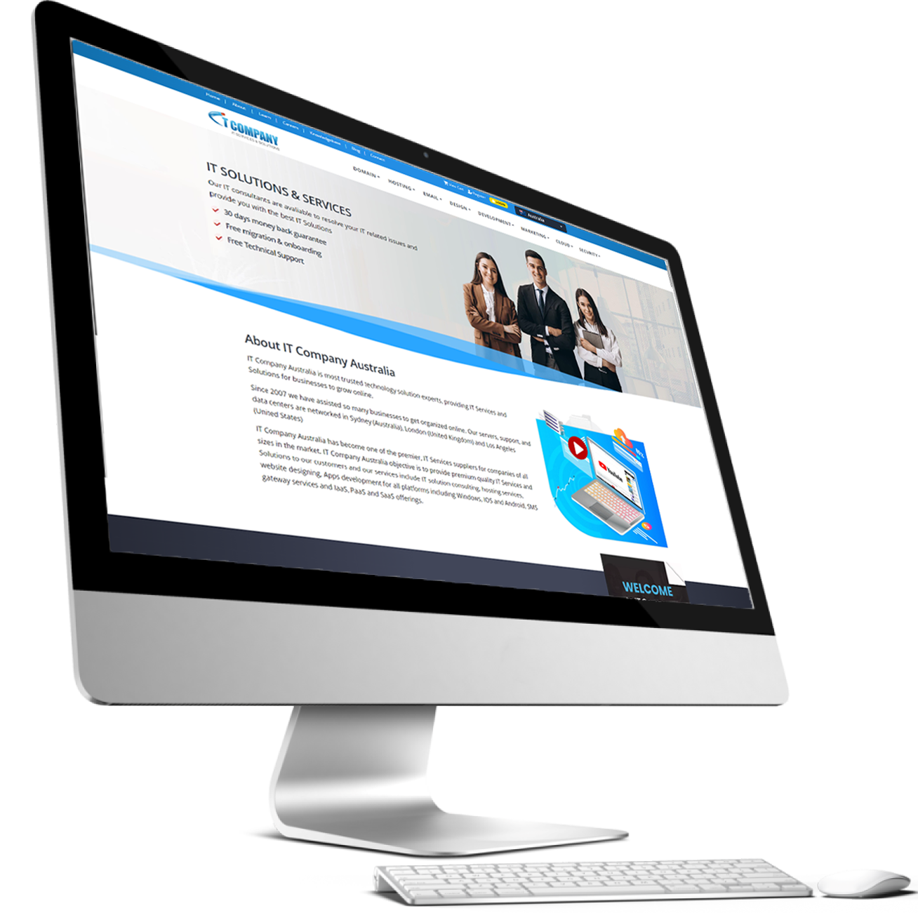


WHY TO CHOOSE
IT COMPANY
When you bring us on board to take care of your business, we guarantee:
99.9% uptime | 24/7 Support | 30% Cost Savings
Genuine tech support from certified experts
Proven ticket resolution success
Fastest response & resolution times
Lower infrastructure costs
SLA-backed services with minimal downtime
Expert guidance for all business scales
Boosted productivity & efficiency
www.itcompany.info

Slide 11














IT COMPANY YOUR RIGHT CHOICE
We specialize in IT support, and over the years, we’ve provided best-in-class support and service to a whole range of reputable businesses and government agencies.
CSAT
GUARANTEE
CUSTOMERS
SECURITY
EXPERIENCE
DOCUMENTATION
P1 TASKS
We have 4.5 CSAT score (Customer Satisfaction Score )
Money-Back Guarantee
98% retained and returned customers
Prioritize Customer Security, With
Top-tier Security Measures
Tech team with a wealth of experience
Less than 1 Hour to Resolve P1 Tasks
Minimum documentation and flexible plans
CALL
LEADING GLOBALS
SUPPORT
RESOLUTION
LOCATIONS
WEBSITES
ONE-STOP
Minimum Call Waiting Duration
24/7
Support
95% First-Call Resolution Rate
10+ HOSTING Locations
5000+ HOSTED Websites
Your one stop solution for all your IT requirements
Trusted Partner & Exclusive Distributor for Leading Global IT Brands

Slide 12
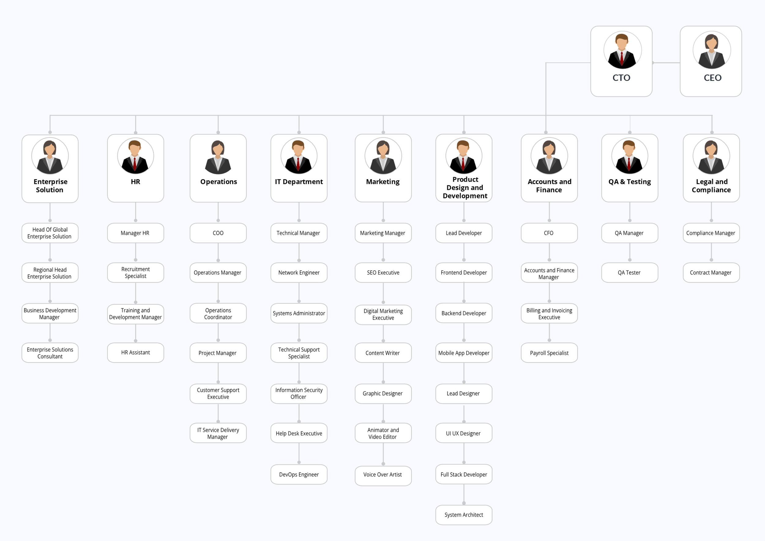

TEAM OVERVIEW
Welcome to the IT Company hierarchy chart, where you can explore the structured organization of our team. This chart outlines the roles and relationships within our company, highlighting the clear path of authority and responsibility.
www.itcompany.services

Slide 13

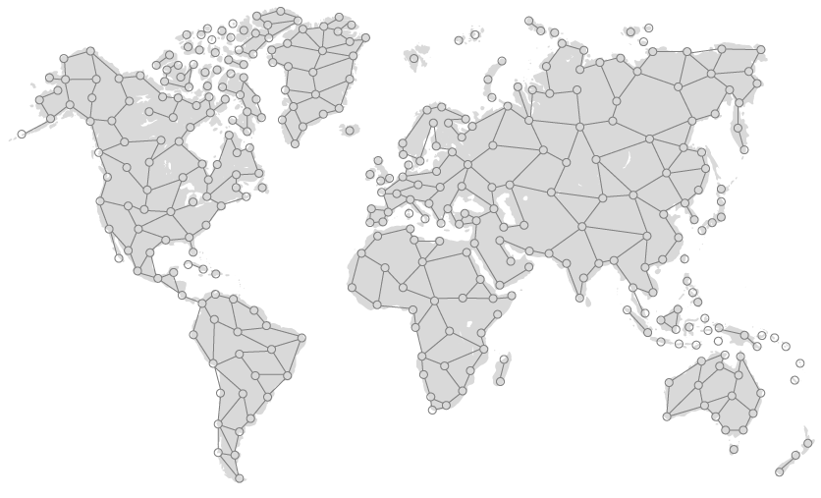














IT COMPANY
LOCAL EXPERTISE, GLOBAL REACH

Slide 14


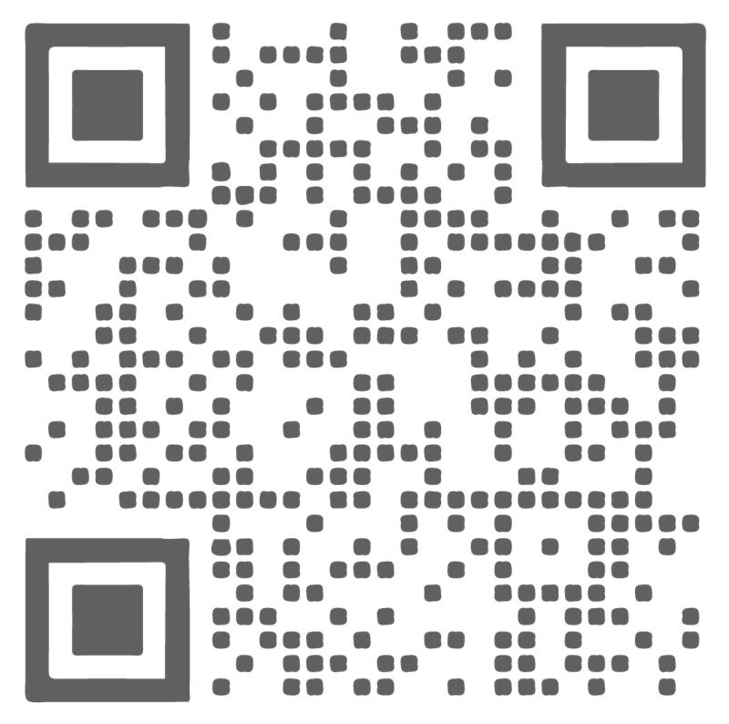




SALES
sales@itcompany.services
Book a Free
15 Minutes
IT Consultation Today
KNOWLEDGEBASE
Find answers to your queries
WEBSITE
www.itcompany.info
SOCIAL MEDIA
SUPPORT
support@itcompany.services
www.itcompany.info
Notes:
How

